Slide 1
ECE/CS 552: Data Hazards
Boone Severson
Lecture notes based in part on slides created by Joshua San Miguel, Mikko Lipasti, Mark Hill and John Shen

Slide 2
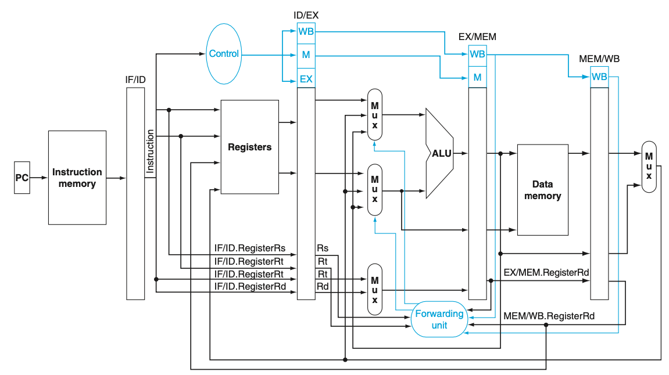
FETCH DECODE EXECUTE MEM WB
Precise Naming: Stage vs Pipeline Register

Slide 3
Lifecycle of MemtoReg
Decode
Execute
Mem
WriteBack
Control
MemtoReg
WB
ID/EX.MemtoReg
WB
EX/MEM.MemtoReg
WB
MEM/WB.MemtoReg
ID/EX
EX/MEM
MEM/WB
M
U
X
ID/EX
MemtoReg
ID/EX.MemtoReg

Slide 4
Pipeline Data Hazards
RAW register data dependence:
  Hazard: when sub is reading [$1] in ID stage, add is still in EX stage and has not written the new value of [$1] to the register file yet
  add $1, $2, $3
  sub $4, $5, $1
Cycle Instruction | 1 | 2 | 3 | 4 | 5 | 6 | 7 | 8 | 9 | 10
add | F | D | X | M | W
sub |  | F | D | X | M | W

Slide 5
Pipeline Data Hazards
RAW register data dependence:
  Hazard: when sub is reading [$1] in ID stage, add is still in EX stage and has not written the new value of [$1] to the register file yet
  add $1, $2, $3
  sub $4, $5, $1
  lw $6, 0($7)
Cycle Instruction | 1 | 2 | 3 | 4 | 5 | 6 | 7 | 8 | 9 | 10
add | F | D | X | M | W
sub |  | F | D* | D* | D* | D | X | M | W
lw |  |  | F* | F* | F* | F | D | X | M | W

Slide 6
RF Bypassing
Cycle Instruction | 1 | 2 | 3 | 4 | 5 | 6 | 7 | 8 | 9 | 10
add | F | D | X | M | W
…
…
sub |  |  |  | F | D | X | M | W
  add $1, $2, $3
  …
  …
  sub $4, $5, $1

Slide 7
RF Bypassing
Cycle Instruction | 1 | 2 | 3 | 4 | 5 | 6 | 7 | 8 | 9 | 10
add | F | D | X | M | W
…
…
sub |  |  |  | F | D | X | M | W
  add $1, $2, $3
  …
  …
  sub $4, $5, $1

Slide 8
MEM-to-EX Forwarding
Cycle Instruction | 1 | 2 | 3 | 4 | 5 | 6 | 7 | 8 | 9 | 10
add | F | D | X | M | W
…
sub |  |  | F | D | X | M | W
  add $1, $2, $3
  …
  sub $4, $5, $1

Slide 9
EX-to-EX Forwarding
Cycle Instruction | 1 | 2 | 3 | 4 | 5 | 6 | 7 | 8 | 9 | 10
add | F | D | X | M | W
sub |  | F | D | X | M | W
  add $1, $2, $3
  sub $4, $5, $1

Slide 10
Load-to-Use Stalls
sub
lw
Cycle Instruction | 1 | 2 | 3 | 4 | 5 | 6 | 7 | 8 | 9 | 10
lw | F | D | X
sub |  | F | D*
  lw $1, 0($2)
  sub $4, $5, $1

Slide 11
Load-to-Use Stalls
sub
nop
lw
Cycle Instruction | 1 | 2 | 3 | 4 | 5 | 6 | 7 | 8 | 9 | 10
lw | F | D | X | M
nop |  |  |  | X
sub |  | F | D* | D
  lw $1, 0($2)
  sub $4, $5, $1

Slide 12
Load-to-Use Stalls
sub
nop
lw
Cycle Instruction | 1 | 2 | 3 | 4 | 5 | 6 | 7 | 8 | 9 | 10
lw | F | D | X | M | W
nop |  |  |  | X | M
sub |  | F | D* | D | X
  lw $1, 0($2)
  sub $4, $5, $1

Slide 13
Load-to-Use Stalls
sub
nop
lw
Cycle Instruction | 1 | 2 | 3 | 4 | 5 | 6 | 7 | 8 | 9 | 10
lw | F | D | X | M | W
nop |  |  |  | X | M | W
sub |  | F | D* | D | X | M | W
  lw $1, 0($2)
  sub $4, $5, $1

Slide 14
Load-to-Use Stalls
sub
nop
lw
Cycle Instruction | 1 | 2 | 3 | 4 | 5 | 6 | 7 | 8 | 9 | 10
lw | F | D | X | M | W
sub |  | F | D* | D | X | M | W
  lw $1, 0($2)
  sub $4, $5, $1

Slide 15
Pipeline Stalls
To stall an instruction at the ID stage:
  Disable PCWrite and IF/IDWrite
  Clear ID/EX control signals to all 0s (i.e., insert nop)
nop

Slide 16
Data Forwarding
RegDst
Branch
MemRead
MemtoReg
ALUOp
MemWrite
ALUSrc
RegWrite
ForwardA
ForwardB
WriteRegister

